Slide 1
TIME - TABLE MANAGEMENT SOFTWARE
Group - ce4
SOURABH LIMBORE (111203031)
AADESH MAGARE (111203032)

Slide 2
Background
All educational institutes require time table for their proper functioning.
Educational institutes regularly face problem of timetable generation / maintenance.
Manual timetable scheduling is time and effort consuming task.
Present solutions to the problem follow fully automated or manual approach and doesn’t support personalization.

Slide 3
ABSTRACT
Timetable generation belongs to the class of combinatorial optimization problems. We have implemented a semi automated approach for solving this constraint heavy problem for educational institutes like College of Engineering Pune (COEP). It will allow the users to make time table as per his/her choice while ensuring that no constraints are violated.
We have developed a desktop application using Object Oriented Programming paradigm with a user friendly interface.

Slide 4
LITERATURE REVIEW
Existing solutions like FET , aSc Timetable and Mimosa Scheduling Software
Features | FET | aSc Timetable | Mimosa
Automatic/Manual | Fully automatic Semi automatic | Both | Both
Platform | Windows, GNU/Linux, MacOS | Windows, GNU/Linux MacOS | Windows, GNU/Linux MacOS
Import data files | Yes | Yes | Yes
Export | Html, csv,xml | Html,xml,csv | Html,xml,csv
Open source | Yes | No | No

Slide 5
Proposed Solution
Features | Proposed Solution
Automatic / Manual | Semi automated
Platform | Windows or GNU / Linux
Import data files | Yes
Export | Html, pdf, ods
Open source | Yes

Slide 6
Features of proposed solution
Quantification of constraints.
Semi-automated approach.
Dynamic checking of constraints.
Venue utilization statistics.

Slide 7
Data mapping and filtering.
User friendly GUI.
Open source.
Export in popular formats (ods, pdf, html).

Slide 8
SYSTEM REQUIREMENTS
The minimum hardware requirements are same as that of Python
Memory (RAM) : 512 MB of RAM required.
Hard disk space : minimum 1GB free space required.
Processor : Intel Pentium 4 or later

Slide 9
The Minimum Software Requirements
Operating System : Windows or GNU / Linux .
Python 2.7 .
Python modules : wxPython, ezodf, pickle, pdfkit.
wxWidgets.

Slide 10
Supported Constraints
Hard Constraints
No clashes in teacher / venue / class timetable.
Batches should not clash with its class timetable
Allocated hours should not exceed maximum number of hours for subject.

Slide 11
Soft Constraints
Maximum teacher workload.
Venue-Class capacity checking.
Compulsory lunch break for class / batch.
Allocated hours should not be less than specified number of hours for the subject.

Slide 12
Implementation
Front End
Grid : wx.grid
Windows : wx.dialog
List : wx.Listctrl
Panels : wx.lib.scrolledpanel
Dropdown : wx.ComboBox
Titles : wx.StaticText

Slide 13
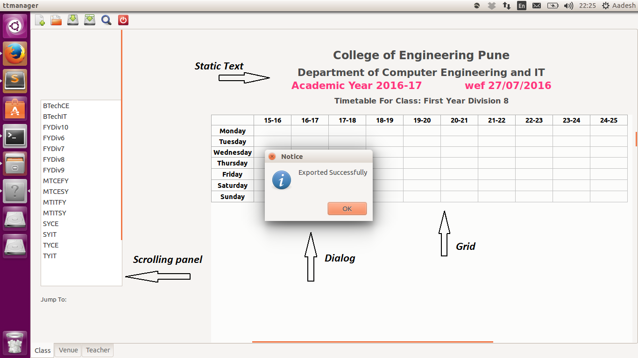

Slide 14
Back end
Backend provides following functions
Insert a normal entry.
Add new teacher / venue / class.
Remove entry.
Find venue utilization.

Slide 15
Export in ods, pdf, html format.
Verify constraints.
Insert lunch entry.
Exceptions :
ExistingEntry exception
ExtraWorkLoad exception
LimitForSubject exception
DailyWorkLoad exception

Slide 16
Future scope :
Automatic timetable generation.
Port to a web-platform.
Improvements in GUI.

Slide 17
Thank You

